Slide 1



FRAUD DETECTION

Slide 2
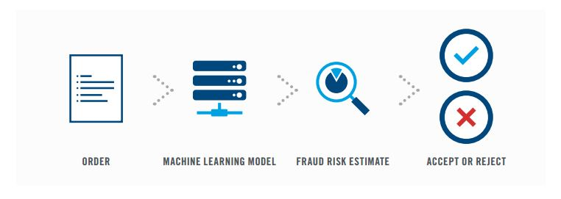
OBJECTIVE
Fraud detection model is among the most complicated
models used for the credit card industry.
A rapid growth in the number of credit card transactions which has led to a substantial rise in fraudulent activities.
Most of the credit card fraud detection
systems are based on artificial intelligence,
Meta learning, pattern matching and
auto-encoders.

Slide 3
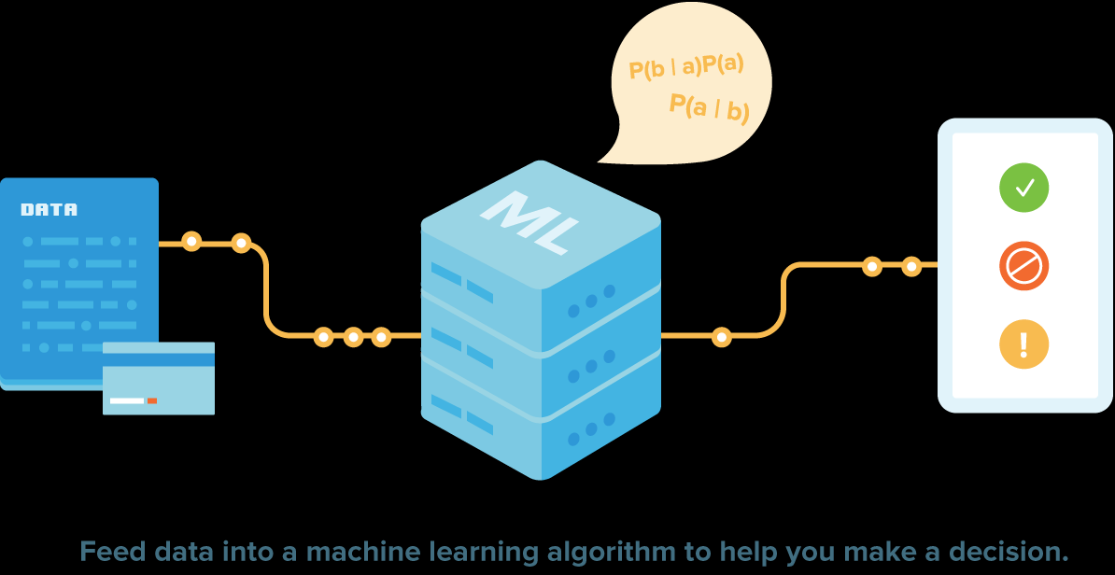

Slide 4
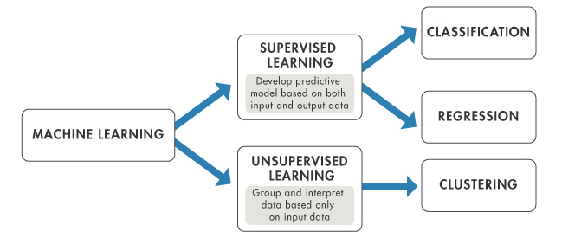
MACHINE LEARNING
“Machine learning is concerned with computer programs that automatically improved their performance through experience”
Limitations:
Machine-learning programs often fail to deliver expected results.
Reasons for this are numerous: lack of (suitable) data, data bias, privacy problems, badly chosen tasks and algorithms, lack of resources, and evaluation problems.

Slide 5

DEEP LEARNING
Deep learning is an artificial intelligence function that imitates the workings of the human brain in processing data and creating patterns for use in decision making.

Slide 6
DEEP LEARNING
Limitations:
It can not draw conclusions in the cross-domain boundary areas.
Unable to learn from limited examples.
It limited in its current form.
It cannot take complex decision beyond any previous training.

Slide 7
AUTOENCODERS

Slide 8
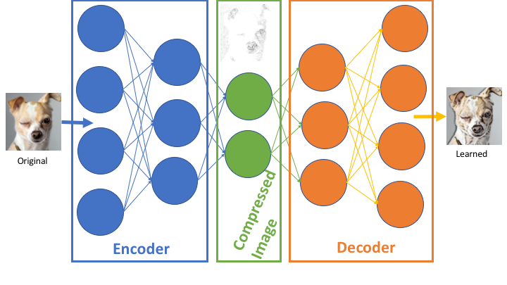
AUTOENCODERS
An autoencoder is a type of artificial neural network used to learn efficient data coding's in an unsupervised manner.
The aim of an autoencoder is to learn a representation (encoding) for a set of data, typically for dimensionality reduction, by training the network to ignore signal “noise.”

Slide 9
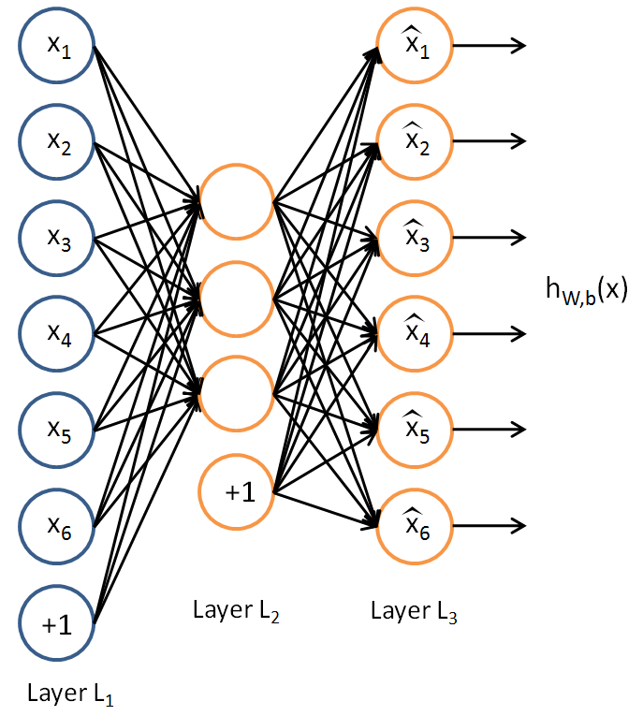
AUTOENCODERS
Key facts about autoencoders
It is an unsupervised ML algorithm
It minimizes the same objective function
It is a neural network
The neural networks target output is its input

Slide 10
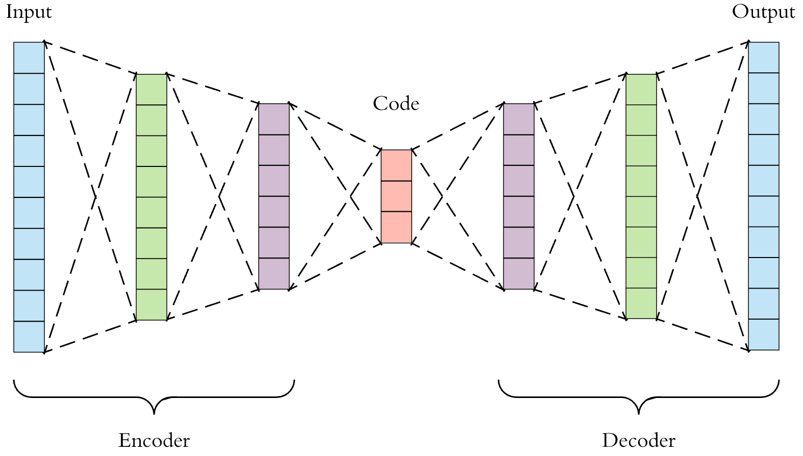



AUTOENCODERS
Components of autoencoders

Slide 11



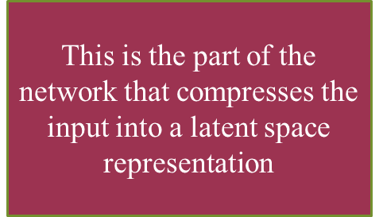
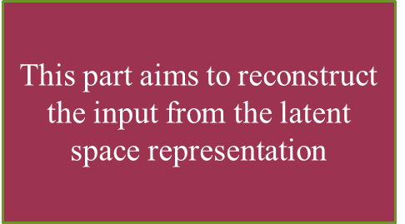
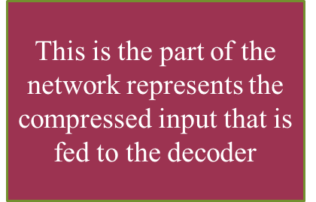

Slide 12
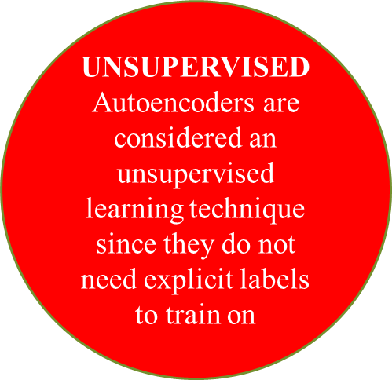
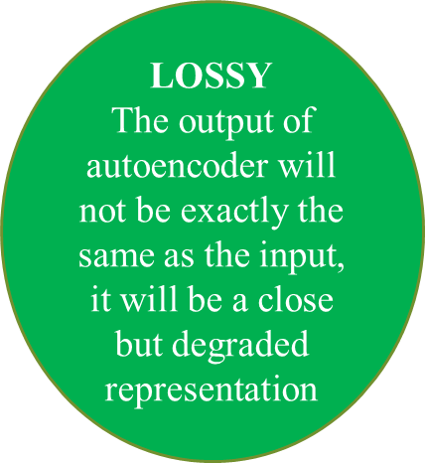
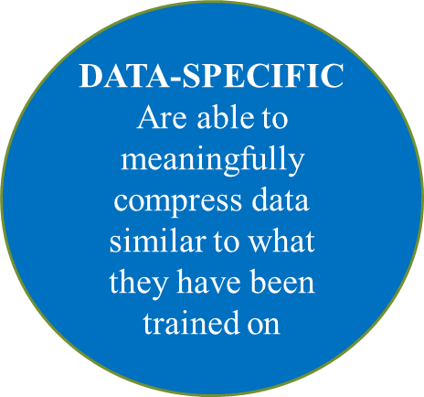
Properties of autoencoders

Slide 13
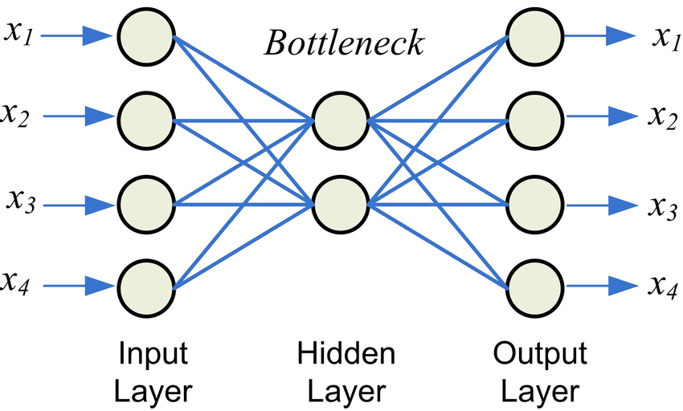
Architecture of Autoencoders
Bottleneck approach is an approach to for deciding which aspects of observed data are relevant information and what aspects can be thrown away.
Compactness of representation, measured as the compressibility
Representation retains about some behaviourally relevant variables

Slide 14
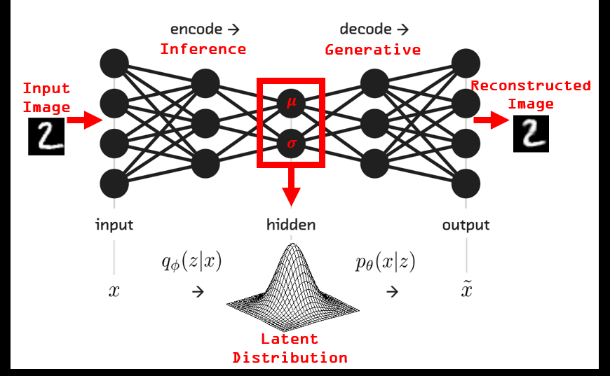
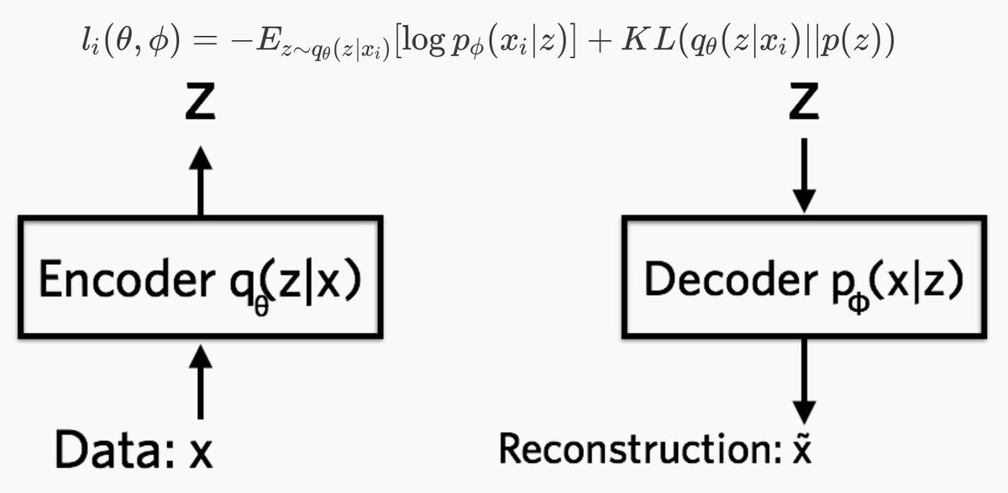
Architecture of Autoencoders
Encoder
In the neural network, the encoder is a neural network that outputs a representation z of data x

Slide 15
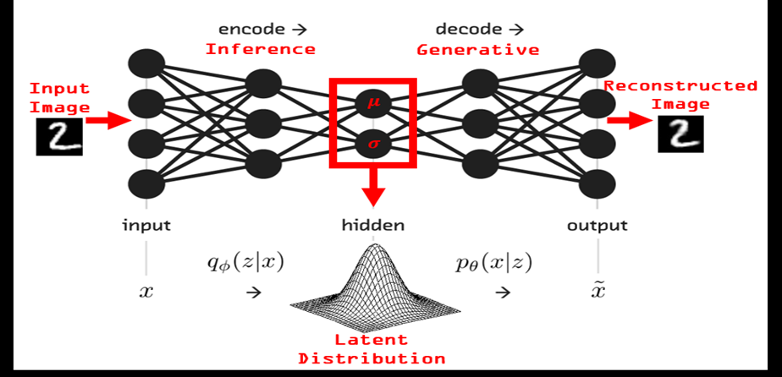
Architecture of Autoencoders
Decoder
In deep learning the decoder is a neural network that learns to reconstruct the data x given a representation z

Slide 16
TYPES OF AUTOENCODERS
Autoencoders
CONVOLUTION AUTOENCODERS
SPARSE AUTOENCODERS
DEEP AUTOENCODERS

Slide 17
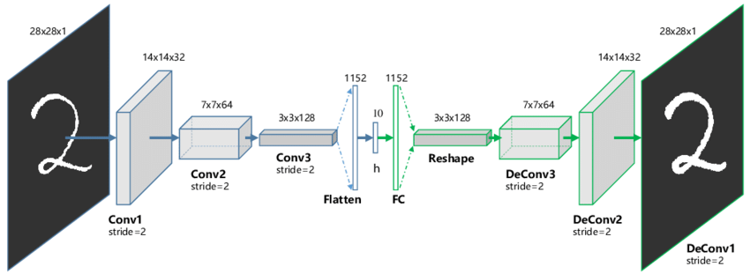
1. Convolution Autoencoders
Convolution auto encoders use the convolution operator to learn to encode the input in a set of simple signals and then try to reconstruct the input from them

Slide 18
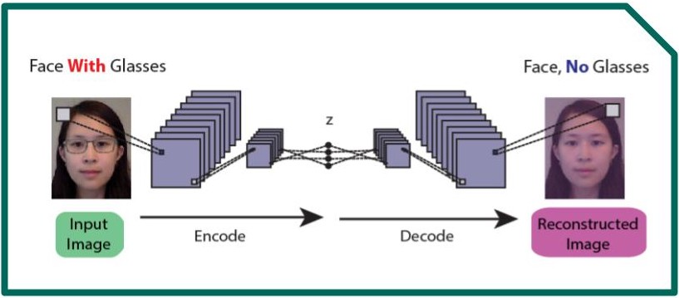
Use case of CAE:
1
Image reconstruction
2
Image colorization
Advanced applications
Learns to remove noise or reconstruct missing parts
3
Noisy version is converted to clean version
The network fills the gaps in the image

Slide 19
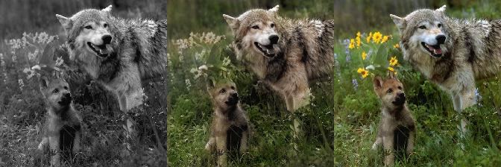
Use case of CAE:
Maps circles and squares from an image to the same image but with colors
Purple is formed sometimes because of blend of colors, where network hesitates between circle or square
1
Image reconstruction
2
Image colorization
3
Advanced applications

Slide 20
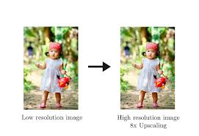
Use case of CAE:
1
Image reconstruction
2
Image colorization
3
Advanced applications
Generating higher resolution images

Slide 21
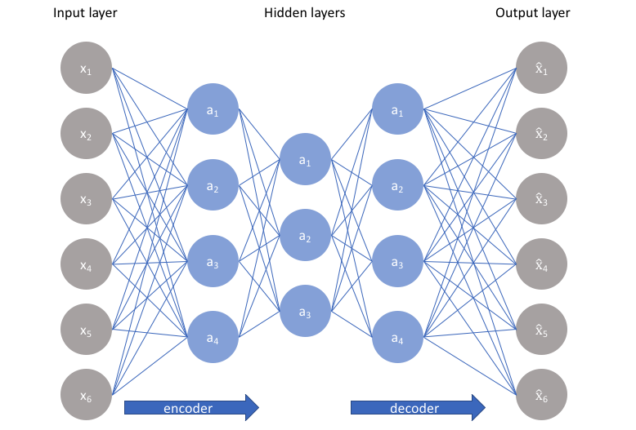
2. sparse Autoencoders
Sparse autoencoders offer us an alternative method for introducing an information bottleneck without requiring a reduction in the number of nodes at our hidden layers

Slide 22
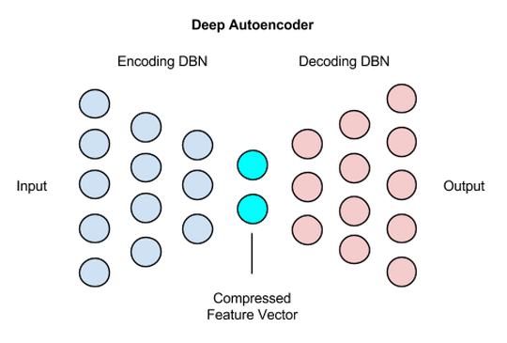
3. Deep Autoencoders
A deep autoencoder is composed of two, symmetrical deep-belief networks
First four or five shows layers representing the encoding half of the net
Second set of four or five layers that make up the decoding half

Slide 23
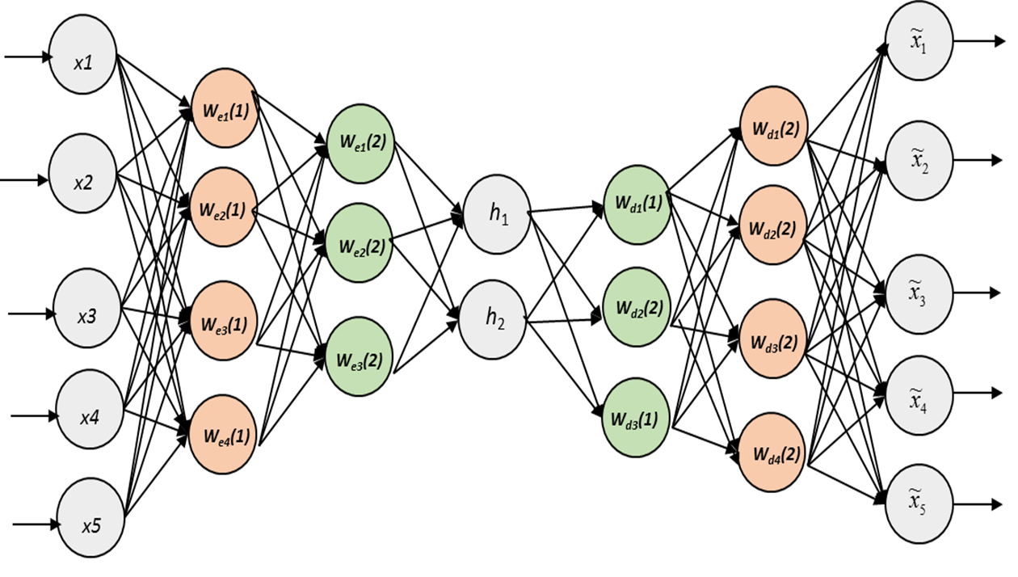
Deep Autoencoders
The first layer of the deep autoencoder learns first order features in the raw input such as edges in an image

Slide 24

Deep Autoencoders
The second layer learns second-order features corresponding to patterns in the appearance of first-order features

Slide 25
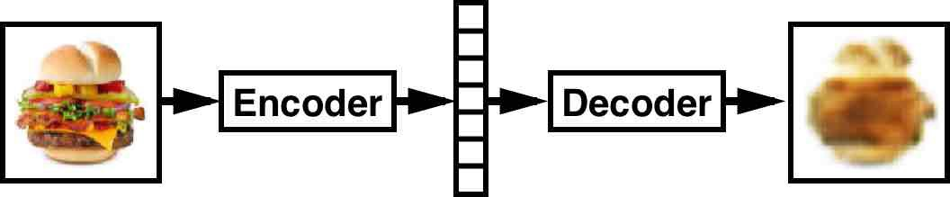
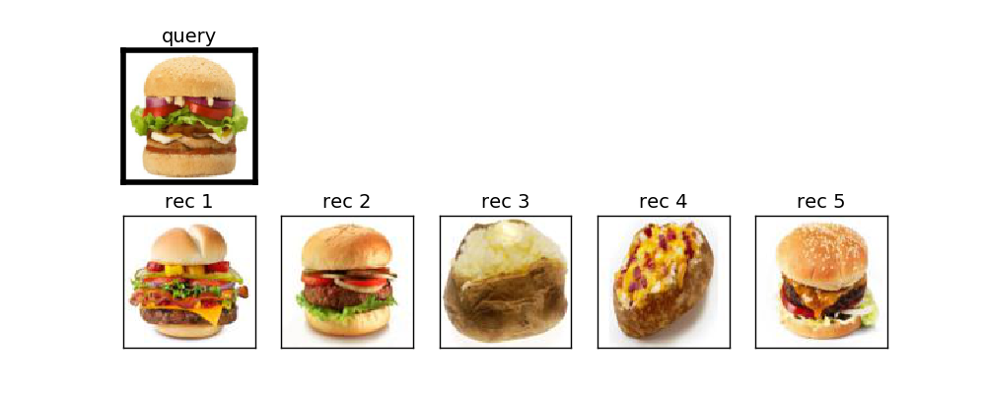
Use Case: Deep Autoencoders
1
Image search
2
Data compression
Topic modelling and information retrieval
3

Slide 26
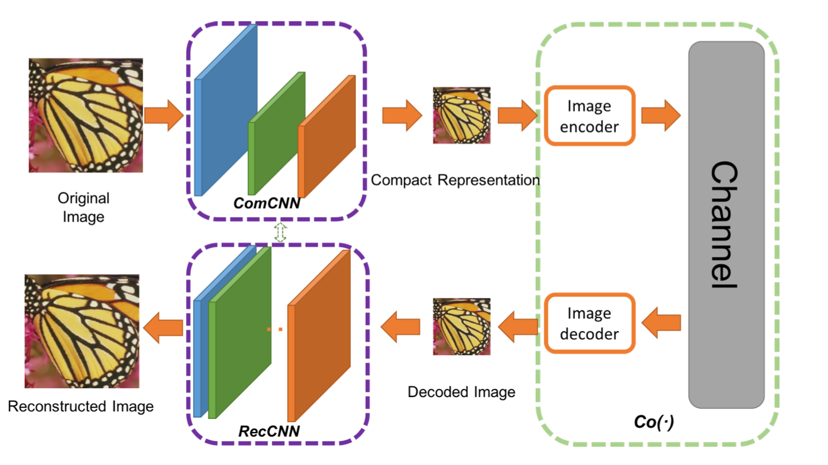
Use Case: Deep Autoencoders
1
Image search
2
Data compression
Topic modelling and information retrieval
3

Slide 27
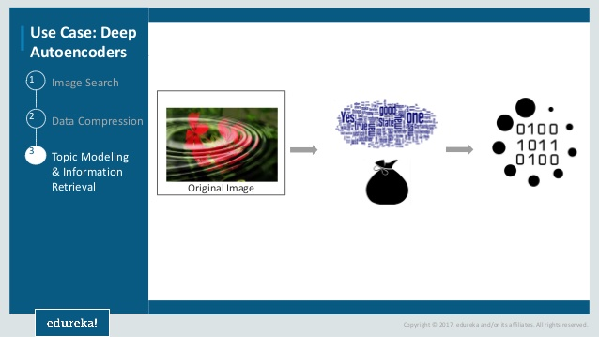
Use Case: Deep Autoencoders
1
Image search
2
Data compression
Topic modelling and information retrieval
3

